Slide 1
Fur as artifice
HE Master Charles de Bourbon, OL
Using fur to ornament clothing in the Current Middle Ages: a study of background and techniques to achieve a period aesthetic
“In England it is always windy, and however warm the weather is the natives invariably wear furs.” – Venetian envoy, 1513

Slide 2
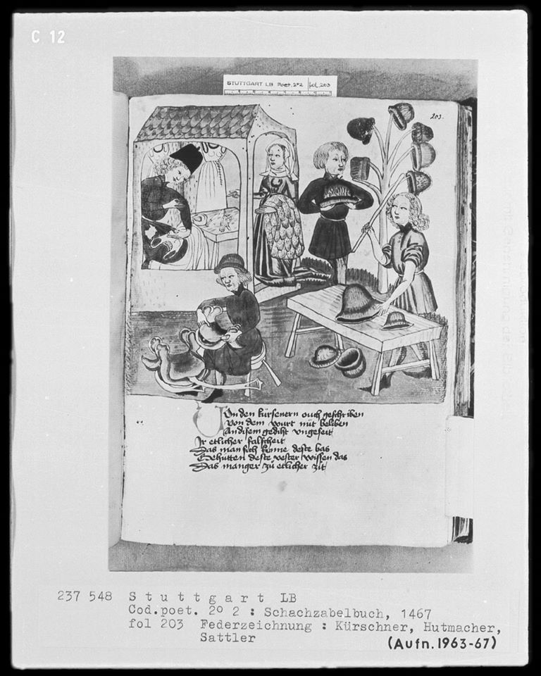
Scope of class
Overview of English fur trade in the 14th-16th centuries
Historical sumptuary
Types of Fur used in period
Construction methods
Tips and Tricks
Fur Sources
Bibliography

Slide 3
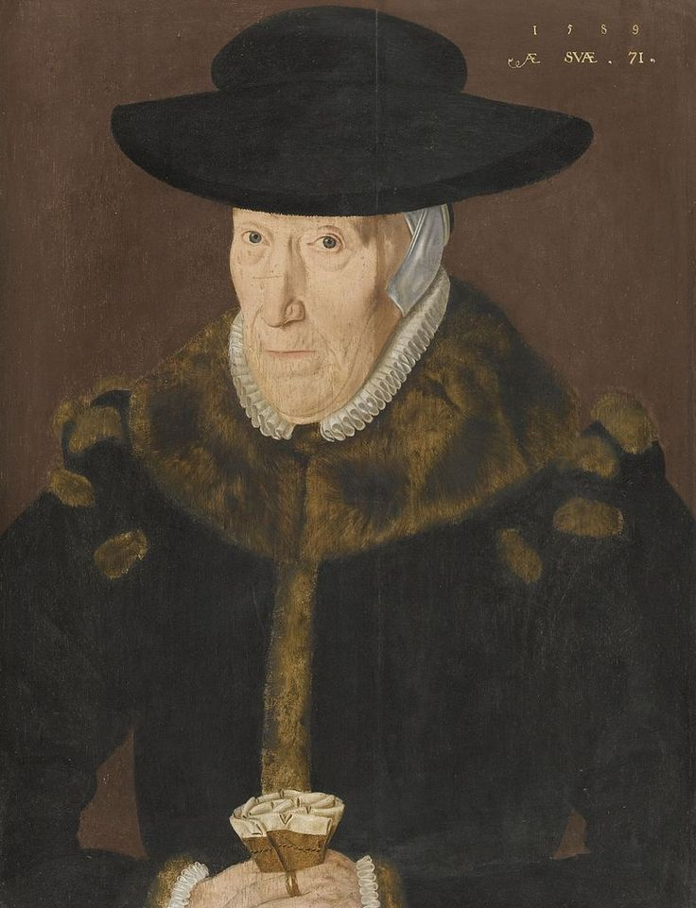
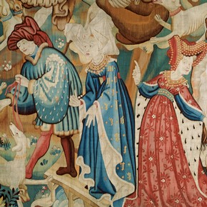
Growth of the Fur Trade from the 14th-16th century
1589 – portrait of a lady aged 71 in a beaver fur lined gown by John Bettes
1425 – detail of the Bear and Boar Hunt tapestry featuring ladies with Miniver or Lettice and Ermine

Slide 4
Growth of the Fur Trade
Fur garments were worn for both warmth and status in pre-14th century Europe.
“Abbot Aelfric wrote in the 10th century of the shoes, hose, gear for horses, bottles, flasks, pouches and clothing which the ‘sutor’ made out of skins and suggested that no one would care to face the winter without his assistance.”
Bustling trade in new and used furs emerges in the 14th century as a result of sumptuary laws.
In the 12th century we begin to see a division of specialties in the craft (guilds): those who work with leather skins were known as tanners, and those who work with fur known as skinners.
By the 13th century London, Oxford, York, and Exeter were centers for Tanning and Skinning industry
Tanners were subdivided by craft: cordwainers, saddlers, glovers, barkers (use tree bark), and whittawyers (use alum)
Skinners were far fewer and highly specialized: tawers prepared the fur and furriers made up the fur

Slide 5
Growth of the Fur Trade - cont.
London emerges as center of English fur trade in the late 13th century
Proximity to bustling port allowed London skinners to move beyond preparing and making up furs to import/export of rare foreign furs.
During the later part of the 13th century the London merchant skinners were among the most influential in the emerging merchant class.
Russia and North-Western Europe emerges as the main supplier of foreign fur, specifically weasel and squirrel, to Europe in the early 14th century primarily exporting to Western Europe through Novgorod, Bruges, and other Hanseatic League centers of commerce.
Fur garments become strong symbols of socio-economic status moving in to the 14th century
By the 14th century among the nobility and country gentry it became tradition to purchase the finest clothes and furs only in London. Local furriers primary source of fur for garments in pre-14th century England
By the 13th century every village had a craftsperson that specialized in dressing skins and furs
Codified sumptuary laws for fur in England emerged in 1337 and underwent major revision in 1363.

Slide 6
Growth of the Fur Trade - cont.
With the growing demand for English wool in the mid 14th century, more merchants made their way to London bringing with them more exotic and rare furs.
By the late 14th century, there was a very close relationship between London skinners and Hanseatic merchants
The Hanseatic League was a commercial and defensive confederation of merchant guilds and their market towns that dominated trade along the coast of Northern Europe. It stretched from the Baltic to the North Sea and inland during the Late Middle Ages and early modern period (c. 13th to 17th centuries)
By the early 15th century, the Hanseatic League controlled almost all (greater than 90%) of all the luxury imported fur coming in to London.

Slide 7
The Life of a Skinner
A Minority of skinners in London were very wealthy and highly influential
one preeminent skinner, Robert Persone, was listed as one of the three wealthiest men in London and served as the mayor of London
These wealthy merchant-skinners and their associated business partners created a group in the 14th century called the Fraternity of Corpus Christi and was renamed in the 15th century, “The Livery of the Skinners Company.”
They were very influential and often dictated prevailing sales practices in London.
Less affluent skinners might have space in someone else’s shop, or even hawk their wares on the street or in taverns.
Wealthy households might employ a skinner full-time and keep them as part of the staff if it was afforded
Margaret Tudor on her marriage in 1509 took with her as part of her household a skinner.
More often, the wealthy would employ skinners on a contractual basis as needed by the house tailor.
The Fraternity and Livery (The Gild)oversaw the records for indenture of apprentices, the freeing of journeymen and the quality control of members of the council.
Skinners followed the same traditional apprentice/master relationship as other trades

Slide 8
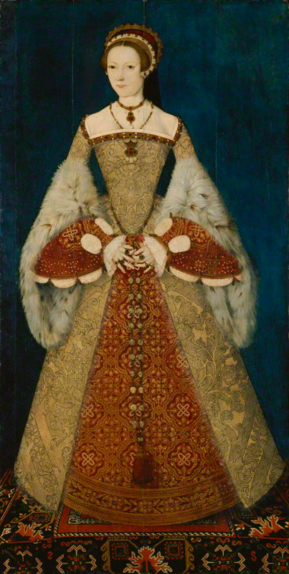
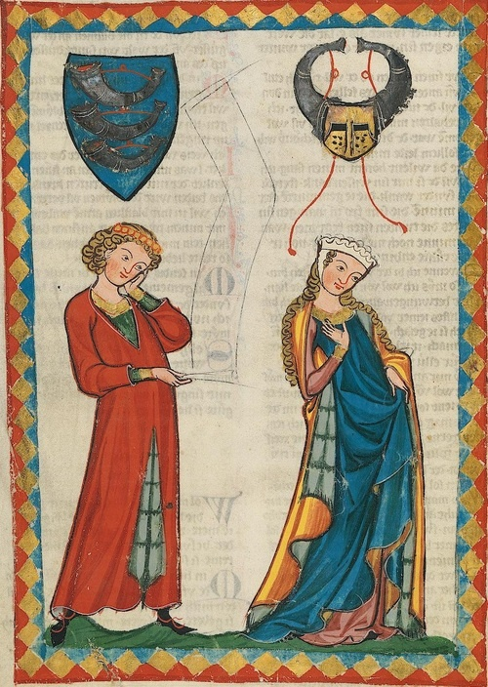
Sumptuary laws in the 14th – 16th century
Queen Catherine Parr in a gown with lynx fur c. 1545
Man and woman with vair trimmed garments c. 1300-1340 Zürich Germany - Heidelberg

Slide 9
Sumptuary
Sumptuary legislation increased the fur trade, as it codified fur as a status symbol.
“In reading over the numerous laws of this kind which were payed in England, one is struck by the fact that at least three kinds of motives seem to have led to their enactment:
(l) the desire to preserve class distinctions, so that any stranger could tell by merely looking at a man's dress to what rank in society he belonged;
(2) the desire to check practices which were regarded as deleterious in their effects and the feeling that luxury and extravagance were in themselves wicked and harmful to the morals of the people;
(3) economic reasons:
(a) the endeavor to encourage home industries and to discourage the buying of foreign goods, and
(b) the desire on the part of the sovereign to have his people save up their money, so that they might be able to help him out in time of need. Sheer conservatism and dislike of new fashions or customs might be mentioned as a fourth issue which led to the passage of the English sumptuary laws”

Slide 10
Sumptuary
1337
First English sumptuary laws enacted – very rigid
Only the Royal family, Prelates, Earls, Barons, Knights, and Clerks with more than 100£ annually were allowed to wear fur
Lack of adherence to strict rules caused later revisions to sumptuary code in 1363
1363
Recognized the futility of limiting wearing of fur. Instead provided guidance on types of furs that could be worn.
Nobility, clerics, and wealthy citizens could wear imported skins: eg. ermine, lettice, Baltic squirrel, and budge
The remaining citizenry allowed native furs: lamb, coney, cat, or fox
Only those with less than 40 shillings worth of goods were excluded from the 1363 recodification
Examples:
Knights and ladies with more than 266£, 13shillings, 4 ducats a year might wear Miniver and Gris;
less prosperous knights could only wear facings of ermine, and only lettice on their hoods
Esquires with >200£ and merchants with >£1000 pounds allowed miniver on their hoods only

Slide 11
Sumptuary
Sumptuary legislation of furs continued through the 16th century as laws went through multiple revisions refining the sumptuary statutes.
As the popularity of certain furs like sable increased and the availability decreased, the laws changed and adapted to reflect current sartorial norms.
1574
Any silk of the color of purple, cloth of gold tissued, nor fur of sables, but only the King, Queen, King's mother, children, brethren, and sisters, uncles and aunts; and except dukes, marquises, and earls, who may wear the same in doublets, jerkins, linings of cloaks, gowns, and hose; and those of the Garter, purple in mantles only.
Woolen cloth made out of the realm, but in caps only; velvet, crimson, or scarlet; furs, black genets, lucernes; embroidery or tailor's work having gold or silver or pearl therein: except dukes, marquises, earls, and their children, viscounts, barons, and knights being companions of the Garter, or any person being of the Privy Council.
Velvet in gowns, coats, or other uttermost garments; fur of leopards; embroidery with any silk: except men of the degrees above mentioned, barons' sons, knights and gentlemen in ordinary office attendant upon her majesty's person, and such as have been employed in embassages to foreign princes.
Satin, damask, silk, camlet, or taffeta in gown, coat, hose, or uppermost garments; fur whereof the kind groweth not in the Queen's dominions, except foins, grey genets, and budge: except the degrees and persons above mentioned, and men that may dispend £100 by the year, and so valued in the subsidy book.
Silk other than satin, damask, taffeta, camlet, in doublets; and sarcanet, camlet, or taffeta in facing of gowns and cloaks, and in coats, jackets, jerkins, coifs, purses being not of the color scarlet, crimson, or blue; fur of foins, grey genets, or other as the like groweth not in the Queen's dominions: except men of the degrees and persons above mentioned, son of a knight, or son and heir apparent of a man of 300 marks land by the year, so valued in the subsidy books, and men that may dispend £40 by the year, so valued ut supra.
Note that the Lord Chancellor, Treasurer, President of the council, Privy Seal, may wear any velvet, satin, or other silks except purple, and furs black except black genets.

Slide 12
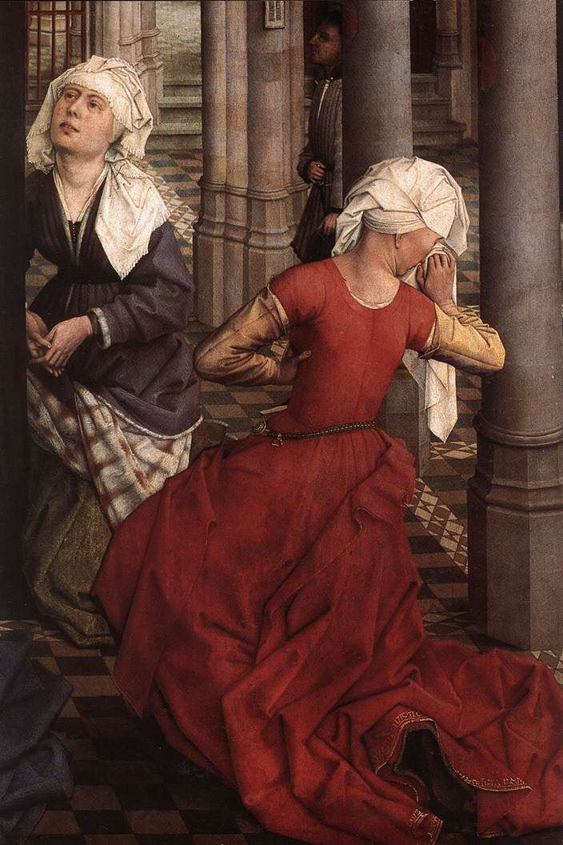
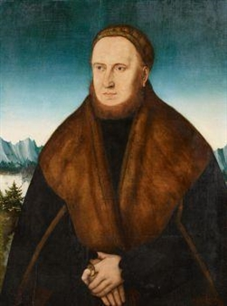
Types of Fur used in the 14th – 16th centuries
PORTRAIT OF A BEARDED MAN IN A CAP AND FUR-LINED COAT (likely Mink or Beaver)
by Danube School, 16th century
Woman with a Fitch lined gown, Seven Sacraments (detail), ca 1445-50. Rogier Van der Weyden

Slide 13
Types of Fur used in period
Ermine – refers to the all-white winter coat of the of a short-tailed weasel called the stoat. In the winter, the stoat’s fur changes from brown to all white with a black tipped tail. Ermine fur was prized and became symbolic of nobility.
Lettis/Letuse/Lettice - skins of the snow weasel. It was a more valuable fur than Minever, but less expensive than ermine, which is was often substituted for.
Vair – Squirrel skins, typically gray in color with white bellies. It was highly prized in the 13th and 14th centuries, but popularity waned moving in to the 15th century (Cinderella)
Coney – rabbit fur, specifically European rabbit fur. The term “rabbit” was used to refer to young coneys and did not become synonymous until the 16th century. Rabbits were introduced in England in the 13th century. Coney fur was used in a variety of colors, and today rabbit skin is the easiest to come by.
Cat – Skins of large wild mountain cat, smaller wild cats and the domestic cat
Fox – are small-to-medium-sized, omnivorous mammals belonging to several genera of the Canidae family. Foxes are slightly smaller than a medium-size domestic dog, with a flattened skull, upright triangular ears, a pointed, slightly upturned snout, and a long bushy tail (or brush). The fox fur typically used rages from reddish brown to gray.
Fitch – skins of the polecat (not a skunk). The European polecat (Mustela putorius) — also known as the black or forest polecat (as well as a some other names) — is a species of mustelid native to western Eurasia and North Africa. It is of a generally dark brown colour, with a pale underbelly and a dark mask across the face. Occasionally, colour mutations, including albinos and erythrists, occur. Compared to minks and other weasels — also fellow members of the genus Mustela — the polecat has a shorter, more compact body a more powerfully built skull and dentition, and is less agile.
Otter – mammal in the same family as minks, martens and weasels. It’s fur typically light to medium brown and reminiscent in texture to other members its family.

Slide 14
Types of Fur used in period – cont.
Beaver - The Eurasian beaver or European beaver (Castor fiber) is a species of beaver which was once widespread in Eurasia. It was hunted to near-extinction for both its fur and castoreum, and by 1900 only 1,200 beavers survived in eight relict populations in Europe and Asia. Beaver fur ranges from chestnut brown to blackish brown.
Minever/Meniver - is an unspotted white fur derived from the winter coat of the ermine, frequently used in the robes of peers. Miniver differs from ordinary ermine fur in that does not include the distinctive black tails of the animals.
Lamb – white, black and reddish brown skins from the lamb were used across all periods. This was one of the the most accessible furs to middle and lower classes.
Budge – lamb skin, specifically lambskin imported from outside England. It was considered a finer quality than local lambs. In the 16th century, Budge came to mean specifically black imported lamp skins.
Genets/Civet – A civet is a small, lithe-bodied, mostly nocturnal mammal native to tropical Asia and Africa, especially the tropical forests. Its fur is typically grey to black and spotted reminiscent of leopard. Foins – Fur of the beach martin, a member of the weasel family
Lucernes/Lynx – lynx is any of the four species within the Lynx genus of medium-sized wild cats. The name "lynx" originated in Middle English via Latin from the Greek word "λύγξ", derived from the Indo-European root "leuk-", meaning "light, brightness", in reference to the luminescence of its reflective eyes.
Leopard - a popular fur in the late 15th and 16th centuries. It is a member of the Filedae family with a wide range in some parts of sub-Saharan Africa, West Asia, the Middle East, South and Southeast Asia to Siberia. The fur is typically tan with darker spots.
Sable - The sable (Martes zibellina) is a species of marten which inhabits forest environments, primarily in Russia from the Ural Mountains throughout Siberia, eastern Kazakhstan, northern Mongolia, China, North and South Korea and Hokkaidō in Japan. Its range in the wild originally extended through European Russia to Poland and Scandinavia. It has historically been hunted for its highly valued fur, which remains a luxury good to this day.
Mink - popular in the late 15th and 16th century. The European mink (Mustela lutreola), also known as the Russian mink, is a semiaquatic species of mustelid native to Europe. It is similar in colour to the American mink, but is slightly smaller and has a less specialised skull. Despite having a similar name, build and behaviour, the European mink is not closely related to the American mink, being much closer to the European polecat and Siberian weasel (kolonok). The European mink occurs primarily by forest streams unlikely to freeze in winter.

Slide 15
Fur in Fashion
Fur, like other materials used in garment manufacture, experienced fluctuations in supply and demand.
The demand for fur changed with the changing popularity of fabrics that the English had access to.
In the 13th and 14th centuries, lighter colored squirrel skins were in high demand . The brilliantly colored fine woolen cloth worn in the 13th and 14th century was perfectly accentuated with the light colored furs, especially those of the squirrel: gris, vair, and miniver. Darker colored skins were used, but the lighter ones were more in demand.
With the dawn of the 15th century, upper class tastes ran to richer colored damasks, velvets, silk brocades, and satins. With the emergence of these more sumptuous fabrics, there was a greater desire for heavier, darker furs like sable, marten, mink, and black lamb. Eventually the lighter, more expensive furs of the 14th century lost popularity and decreased in price
It was common practice to mix furs based on what was visible and what remained unseen
Less costly fur could be used to line a garment, but the visible facings (trim) would be more expensive furs.
More expensive skins like ermine, sable, and marten were used as facing
Less expensive flatter skins usually of the same color, like belly skins, were used as lining.
It was not uncommon to only face garments with fur.
Skinners, in the mid-15th century set up standards by which pelts were worked to ensure that only the highest quality skins were used.
This marks a shift from prescribed numbers of skins for a garment to working each skin to a prescribed size.

Slide 16
Fur in Fashion – cont.
By the mid 16th century, furs were again impacted by the ever changing fashion of the day
Furs slowly lost their prestige and standing as a status symbol. They were still worn, but more often by older people less caught up in the mode of the day.
Furs were still commonly used to line clothing for warmth but were replaced by trims, laces, embroidery, and other artifice as means of fashionable garment augmentation.
Wardrobe accounts in the 16th century gradually contain less and less fur than did accounts in the preceding centuries.
Garments of state still retained fur, and to this day in England various robes and garments of state employ fur. Ermine is perhaps the best example.
The wealthy were spending extravagantly not on furs but on fabrics of an almost unbelievable richness
Patterned velvets, jeweled brocades, shimmering cloths of gold and damasks, as well as silks and taffetas.
From accounts for purchases for Field of the Cloth of Gold: “purple gold tissue, ground silver raised with gold and silver tissue, vellat pearled with gold.” There is very little mention of fur purchases in the accounts.
Those who could afford to and wished to do so, did from time to time add costly furs to these amazing clothing. Due to the dwindling supply and demand for fur, it often was prohibitively expensive to purchase luxury furs, so even royals used facings of fur sparingly and they were made such that they could be reused.

Slide 17
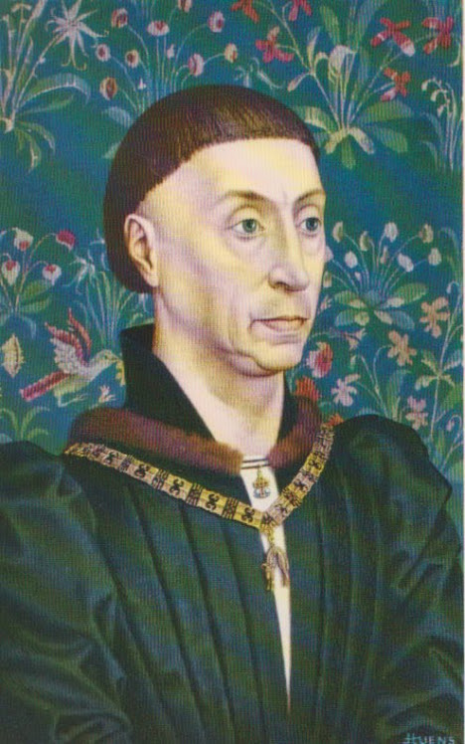
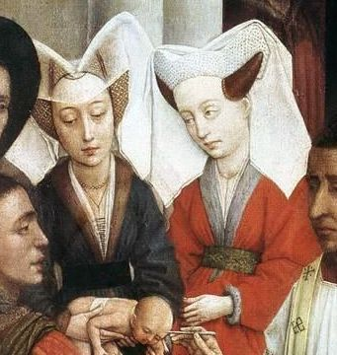
Construction techniques
Ladies with Sable and Squirrel collars c. 1440 van der Weyden
Phillip the Good with Mink trimmed collar c. 1419, Jan Zonder Vrees

Slide 18
Construction
Supplies
Direction of pile
Marking your patterns
Cutting the fur
Interlining, facing and lining
Stitching
Finishing
Tips and tricks

Slide 19
Supplies
Razor blades
Waxed thread
Medium hand sewing needle
Bias tape
Medium weight fabric for interlining: ie linen or broadcloath
Tailor’s chalk
Thimble

Slide 20
Check up on it!
When using real fur, you need to check to make sure the fur will lie in the proper direction. Hold the fur up and look to see where the hair naturally falls.
fur would probably be running down from neck to hem, so you want to cut your pieces with this natural flow in mind.
Sleeves run down from shoulder to cuff
Take some time as well as to comb the fur and to make sure it is clean of any debris.

Slide 21
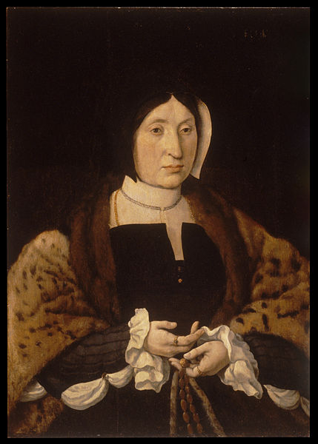
On your mark!
On the backside of the hide, you will make marking which follow the pattern for the item you want to make. Make these markings in dark enough ink so that you can easily see them. If the fur is dark, you might need to use chalk or something which will stand out.
Woman in a leopard fur cloak c. 1535-40, Jan Cornelisz Vermeyen

Slide 22
The first Cut is the deepest
Once you have created patterns for the fur pieces, you can begin to cut. Take the knife or the razor blade and move this sharp edge along the markings you created. Make sure to cut from behind, not cut the fur itself. In fact, don’t pierce the skin enough to cut the fur. Once you have cut as much as you can, then gently pull the piece of fur apart. This will allow you to keep the fur hairs in place.

Slide 23
Back it up
Always back your fur with some kind of sturdy fabric. Do not face the fur, rather treat the fur and the lining as one piece. Fur can be delicate, and given the wear and tear we put our clothing through extra stability is needed to preserve the fur. Additionally, it allows you to do more seaming with the fur, because you have a backing fabric anchoring your work.
When possible, face your fur with bias tape. You can then stitch the bias tape to your garment and tack the edge down, or you can tack the bias tape to the lining fabric of the fur first and apply the fur like a separate garment. Both methods are period. The bias tape allows you to use tighter stitches and the ability to remove the fur.

Slide 24
Sew little time
If possible hand sew – it is gentler on the fur than a machine. Be gentle when pushing your needle through the fur; don’t punch it through. I like to use thinner needles as well. A leather thimble is especially helpful
If hand sewing is not an option (I rarely follow my own advice) use the longest possible basting stitches. You are punching holes in skin, so essentially you are making a line of perforations that weaken the hide – minimize the impact by spreading out the stitches

Slide 25
Finish line!
Once the fur has been applied, use a beard brush to go over your fur to comb out the hairs from the stitches. Some folks will use a needle to go in and pick out the fur, but a stiff bristle brush works exceptionally well

Slide 26
Tips and tricks
Grading a curve – try to avoid cutting curved strips whenever possible. Instead, cut straight strips and use tiny darts or seaming to grade your curve. This serves two purposes:
Maximize the fur – you can get more out of your fur with straight cuts than you can with curved cuts
Exception: sometimes used coats are already have a curved hem; it’s fine to follow the curve of the already constructed curved hem.
Ensure correct pile – taking tucks in the fur allows you to curve the pile to follow the line of the garment.

Slide 27
Tips and Tricks – Fur Coats (Cutters)
It is perfectly period to repurpose Aunt Ida’s old fur coat
Records of furs handed down from one generation to the next and repurposed. John of Gaunt bequeathed his wife his fur which he acquired from the Duchess of Norfolk
Wardrobe accounts of Henry, Earl of Derby account for furs purchased new and used
There was a thriving second hand fur trade in late-medieval England.
Chief crime furriers were accused of were mixing old and new furs

Slide 28
Tips and Tricks – Fur Coats (Cutters)
If you are using a vintage fur coat, have some leather conditioner on hand. Sometimes the hide on fur coats can become brittle, so once you remove the lining, apply conditioner to the pelt and let it sit overnight. This will rejuvenate the hide and make it more durable.
Removing the lining from a fur coat is easy, except when it’s not. Typically the lining will be easy to remove around the bulk of the garment due to the fact very loose wide stitches are used to secure the lining. This is not true on the pocket areas. Typically the fur is tightly stitched to a binding and then sewn to the lining. Be careful;, because you need the pockets intact, as they will allow you to have an uninterrupted piece once they are closed up.

Slide 29
Tips and Tricks – Fur Coats (Cutters) 2
Open the coat up to maximize long flat cuts.
Carefully remove sleeves – you can open up the sleeves separately
Open up the shoulders and lay flat – you now have one flat surface from which to cut your pieces
Removing the lining from a fur coat is easy, except when it’s not. Typically the lining will be easy to remove around the bulk of the garment due to the fact very loose wide stitches are used to secure the lining. This is not true on the pocket areas. Typically the fur is tightly stitched to a binding and then sewn to the lining. Be careful;, because you need the pockets in tact, as they will allow you to have an uninterrupted piece

Slide 30
Sources for fur
EBay – searching eBay for old fur coats is one of the most successful ways to find inexpensive fur coats that you can repurpose. Try search terms like: fur, cutter, craft, coat (type of fur)
Vintage – resale shops and second hand stores like Goddwill are great places to find cheap used fur coats.
Events – SCA events, Cons, and Pow-Wows often have merchants that are selling pelts and used fur coats. I typically find them to be a bit overpriced and only use when desperate.
Leather stores – Stores like Tandy leather typically carry fur pelts that you can use to piece to create fur trims and facings
China – If you are willing to place a bulk order to China, you can purchase fur plates relatively inexpensively. I have never attempted this, because I have not had anyone interested in doing a bulk order.

Slide 31
Real vs. Faux
Choosing real fur over fake fur is a matter of preference. I personally prefer to work in real vintage fur, as I receive a sense of authenticity in knowing that I am closer to period than using faux.
Faux fur has some specific challenges as it can look cheap, ratty and wear much more poorly than real fur. You can find high-end faux fur that looks real, but it is usually fairly expensive.
Using faux fur should be approached very similarly to real fur, but it is much easier to sew on your machine as the backing tends to be a loose weave fabric-type construction

Slide 32
Bibliography
Veale, Elspeth M. The Fur Trade in the Later Middle Ages: Oxford University Press, 1966.
Wieck, Roger S. Illuminating Fashion: Dress in the Art of Medieval France and the Netherlands: Morgan Library and Museum, 2011
Morrison, Elizabeth. Imagining the Past in France: History in Manuscript Painting 1250-1500: Getty Publishing, 2010
Duekers, Rob. The Limbourg Brothers: Nijmegen Masters at the French Court 1400-1416: Ludion Press
Inglis, Erik. Jean Fouquet and the invention of France: Art and Nation after the 100 years War: Yale University Press, 2011
Arnold, Janet. Patterns of Fashion 3: The Cut and Construction of Clothes for Men and Women C. 1560-1620: Drama Publishers
Arnold, Janet. Queen Elizabeth’s Wardrobe Unlock’d: Maney Publishing. 1988
Newton, Stella Mary. Fashion in the Age of the Black Prince: Boydell Press, 1980
Pippioner, Francoise. Dress in the Middle Ages: Yale University Press, 2000
Who wears what - http://www.elizabethan.org/sumptuary/who-wears-what.html
Hunt, Alan: Governance of the Consuming Passions: A History of Sumptuary Law; New York, St Martin’s Press ⓒ 1996
Baldwin, Frances Elizabeth. Sumptuary Legislation end Personal Regulation in England: A Dissertation, 1923
Gaubert, P., Cordeiro-Estrela, P. (2006). Phylogenetic systematics and tempo of evolution of the Viverrinae (Mammalia, Carnivora, Viverridae) within feliformians: Implications for faunal exchanges between Asia and Africa . Molecular Phylogenetics and Evolution
Wozencraft, W. C. (2005). "Order Carnivore". In Wilson, D. E.; Reeder, D. M. Mammal Species of the World (3rd ed.). Johns Hopkins University Press.
Schwebke, Phyllis. How to Sew Leather, Suede and Fur: Simon and Schuster, 1966
Schiller, Marie. The Squirrel Fur Trade in 14th Century Novgorod: University of Minnesota, 2010 (article)

